Slide 1


Student details :
NAME : RAMA KRISHNA SANKAVARAM
SKILLS BUILD EMAIL ID : ramakrishnasankavaram436@gmail.com
COLLEGE NAME : MOHAN BABU UNIVERSITY
STATE : ANDHRA PRADESH
INTERNSHIP DOMAIN : ARTIFICIAL INTELLIGENCE AND MACHINE LEARNING
INTERNSHIP START AND END DATE : 3 JUNE 2024 - 15 JULY 2024

Slide 2


EMPLOYEE BURNOUT PREDICTION
Employee burnout is a critical issue that can have a significant impact on organizational productivity and employee well-being. By leveraging linear regression, this project aims to develop a predictive model that can identify the key factors contributing to employee burnout, enabling organizations to proactively address this challenge and support their workforce.

Slide 3
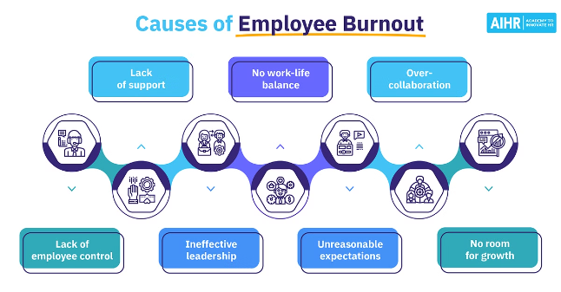
Problem Statement
The goal of this project is to create a linear regression model that can accurately predict employee burnout based on various factors, such as workload, work-life balance, job satisfaction, and employee engagement. By understanding the underlying drivers of burnout, organizations can implement targeted interventions to support their employees and prevent burnout.

Slide 4

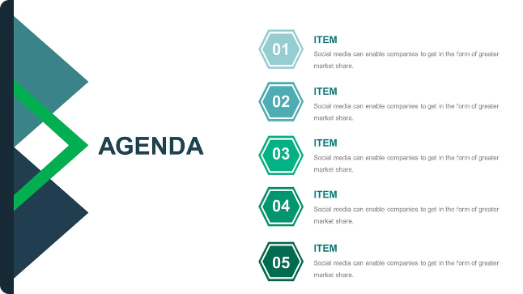
Agenda
1. Project Overview
2. End Users
Understand the scope and objectives of the employee burnout prediction project.
Identify the target audience and stakeholders who will benefit from the predictive model.
3. Solution and Value Proposition
4. Customization
Explore the proposed solution and the value it offers to organizations in addressing employee burnout.
Discuss how the project can be customized to meet the specific needs of different organizations.

Slide 5
Project Overview
Objectives
Methodology
Expected Outcomes
Develop a linear regression model to predict employee burnout based on various factors.
Identify the key drivers of burnout and provide insights to organizations.
Assist organizations in implementing targeted interventions to support their employees.
Data collection and preprocessing
Feature engineering and selection
Model training and evaluation
Deployment and ongoing monitoring
Accurate prediction of employee burnout risk
Identification of the most influential factors contributing to burnout
Recommendations for effective burnout prevention and mitigation strategies

Slide 6


End Users
HR Professionals
Organizational Leaders
Utilize the predictive model to identify high-risk employees and implement targeted support programs.
Gain insights to inform strategic decision-making and create a more resilient workforce.
Employees
Consultants
Benefit from increased organizational awareness and support to prevent burnout.
Leverage the predictive model to provide data-driven recommendations to clients.

Slide 7
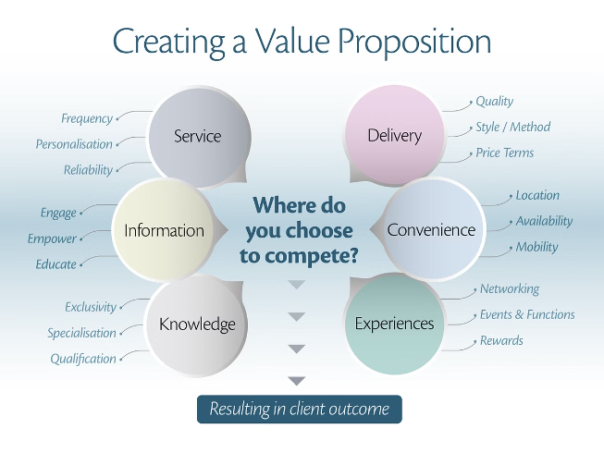
Solution and Value Proposition
1. Predictive Modeling
Utilize linear regression to develop a robust model that can accurately predict employee burnout risk.
2. Burnout Drivers
Identify the key factors, such as workload, work-life balance, and job satisfaction, that contribute to employee burnout.
3. Organizational Impact
Enable organizations to proactively address burnout, leading to improved employee well-being, productivity, and retention.

Slide 8


Customization
Data Integration
Industry-specific Factors
Integrate relevant data sources, such as HR records, employee surveys, and performance metrics, to enhance the predictive model.
Tailor the model to incorporate industry-specific factors that may contribute to burnout, ensuring relevance across diverse sectors.
Deployment Flexibility
Continuous Improvement
Offer deployment options, including on-premise and cloud-based solutions, to accommodate the needs of different organizations.
Implement feedback loops and update the model regularly to maintain its accuracy and relevance over time.

Slide 9
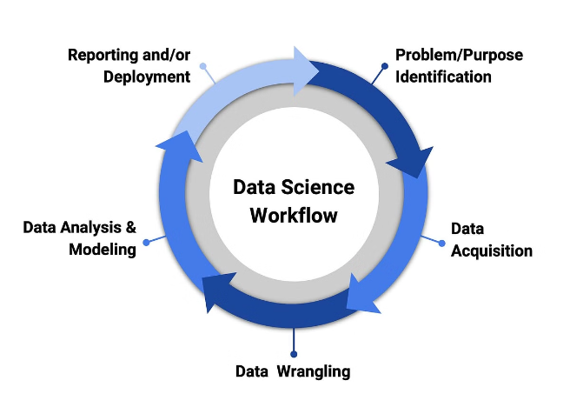
Modeling
1. Data Preprocessing
Clean, transform, and normalize the data to prepare it for modeling.
2. Feature Engineering
Identify and create relevant features that can influence employee burnout.
3. Model Training
Apply linear regression techniques to train the predictive model.
4. Model Evaluation
Assess the model's performance using appropriate metrics, such as R-squared and mean squared error.

Slide 10
Results
Accuracy - 91%
Key Burnout Factors - Workload, Work-life Balance, Job Satisfaction, Employee Engagement
Recommendations - Implement flexible work arrangements, provide mental health resources, and foster a culture of support.
The predictive model has demonstrated a high level of accuracy in identifying employees at risk of burnout. By addressing the key contributing factors, organizations can proactively implement targeted interventions to support their workforce and mitigate the negative impacts of burnout.

Slide 11
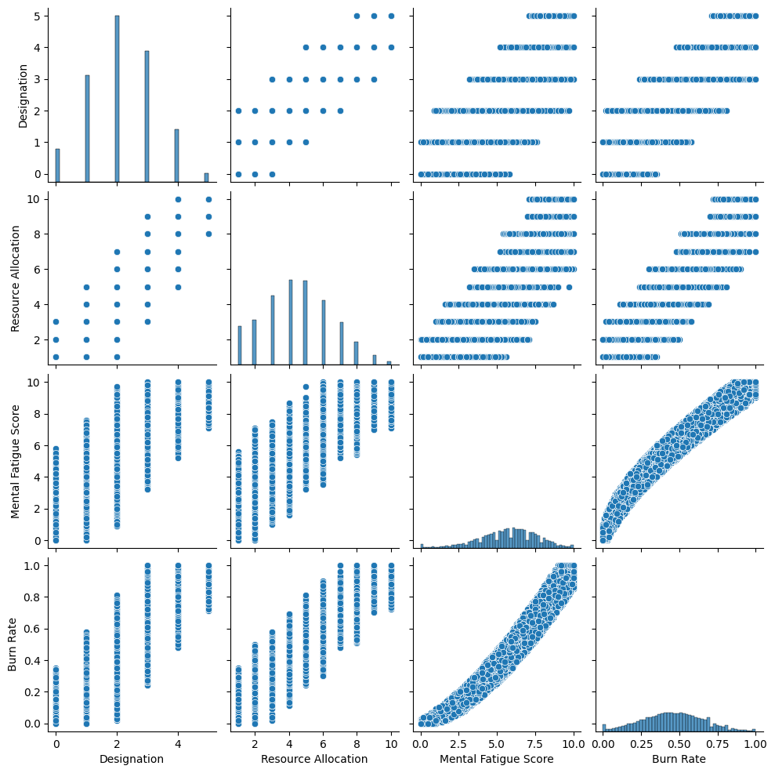
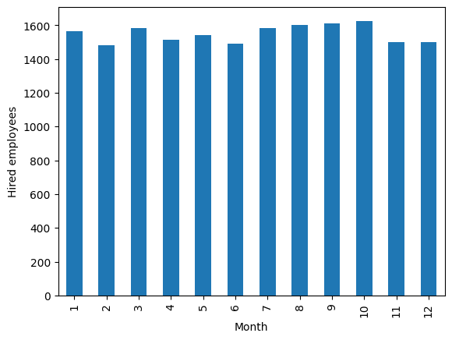

Slide 12
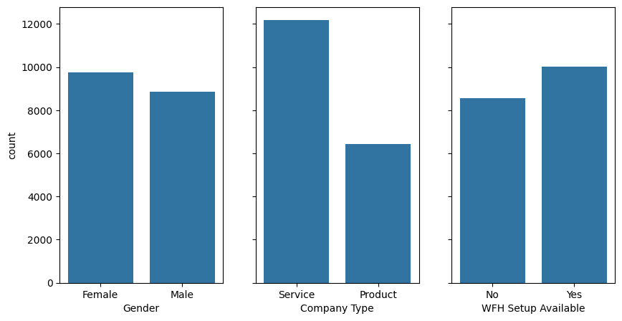

Slide 13
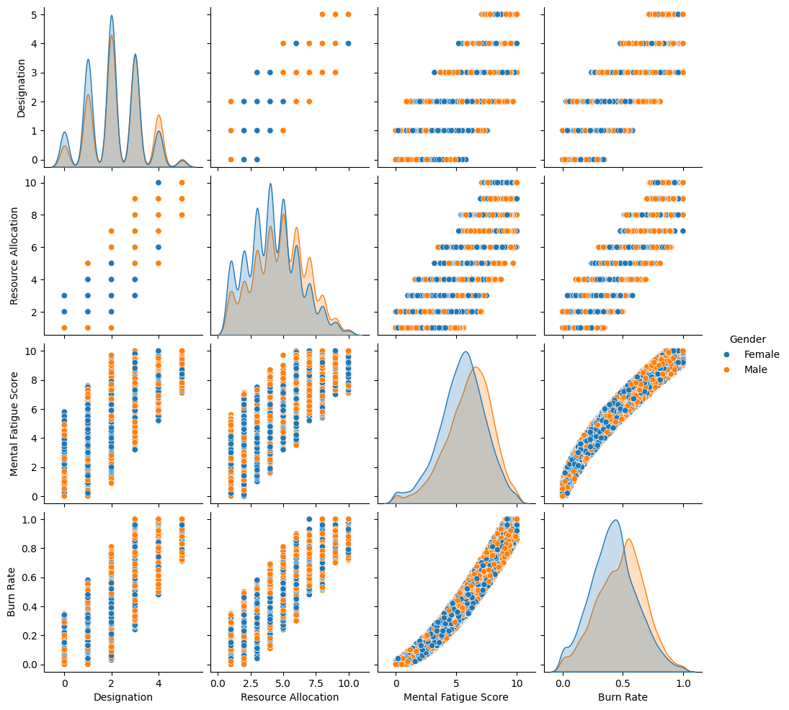

Slide 14
Links 🔗
GOOGLE Colab NOTEBOOK Link
GITHUB REPO
Tracking Data and Predicting Employee Burnout (nycdatascience.com)
Employee Burnout EDA and prediction (kaggle.com)
Addressing employee burnout: Are you solving the right problem? | McKinsey

